Slide 1


September, 2026
Investment Approach

Slide 2

Objective & Investment Philosophy
Focus on consistency of return and risk moderation by
investing in Multinational Companies listed in India.
Objective
Investments into listed companies in India in which the foreign shareholding is over 50% and/or the management control is bestowed in foreign company and/or the technological and managerial know-how brought in by foreign partner/investor.

Slide 3
4P Strategy – Stock Selection
4P
Past Analysis
Business Moat /Market Share
Operating efficiency
Working Capital Management
Balance sheet growth
ROE And ROCE growth etc
Present Analysis
Current vs Historical
Valuation, Margins, leverage, Asset Turnover
Capacity and utilisation
Capex and Cashflow
Pedigree
Management Experience and Qualification
Corporate Governance Practices
Shareholding patterns
Potential
Sector Outook Favourable Macro
Sufficient capacity
Outstanding Order Book,
Multi year Contract, Client Addition,
Product Pipeline etc
Companies to undergo 4 P Analysis to make it to the Universe

Slide 4
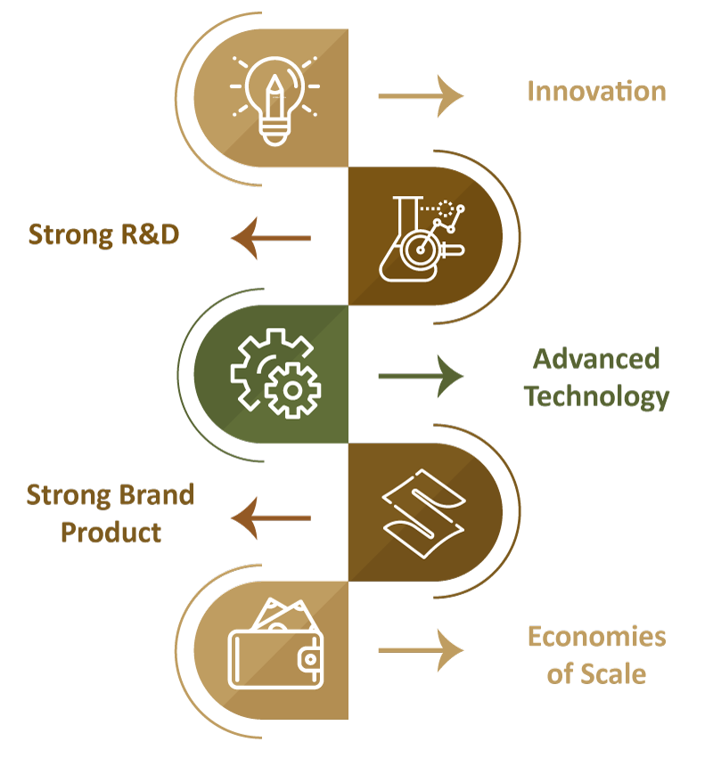
Successful Business Model
MNC’s benefit from the economy of scales by spreading R&D expenditures and advertising costs over their global sales, pooling global purchasing power over suppliers, and utilizing their technological and managerial know-how globally with minimal additional costs.
MNC’s can use their global presence to take advantage of underpriced labor services available in certain developing countries, and gain access to special R&D capabilities residing in advanced foreign countries

Slide 5
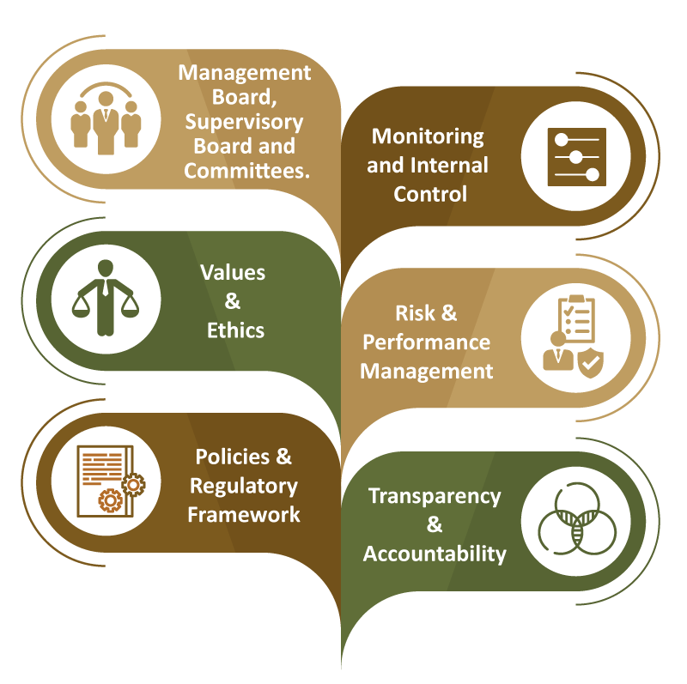
Strong Corporate Governance
MNC’s are generally rated high for their corporate governance standard.
MNC’s depict high transparency and accountability with well laid out policies and regulatory framework, internal control and risk management.
This provide good comfort for an investor who would not fall prey to any negative impact on investment due to corporate mis-management and fraud.

Slide 6
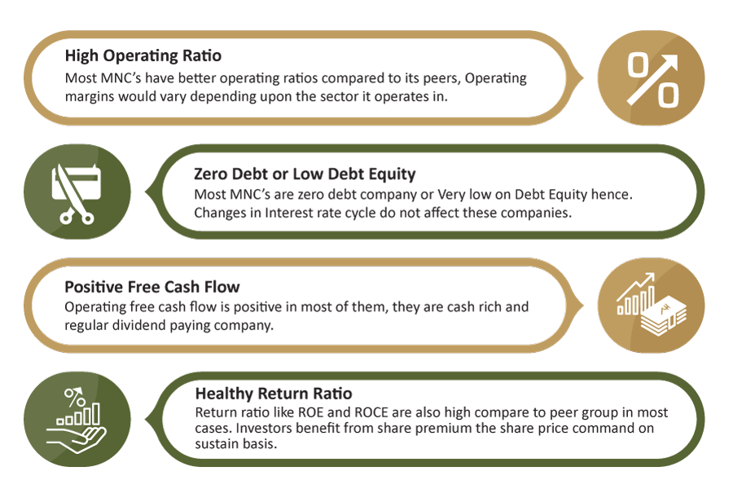
Healthy Balance Sheet

Slide 7
Special Opportunity
MNC companies during the holding period provides healthy dividend and capital appreciation by earnings growth and sometime carries an additional trigger for value appreciation in form of corporate actions like Open offers, Buybacks and Delisting etc. This usually add substantial appreciation to the share price enhancing investors ROI. Below are some illustrations of the same.
Sr. | Company | Corporate Action | Announcement date | Price before Announcement | Date | Price on closure of offer | % Gain
1 | Fulford India | Delisting | 25-Apr-14 | 682 | 30-Jul-15 | 2400 | 252%
2 | Alfa Laval | Delisting | 16-Sep-11 | 1965 | 12-Apr-12 | 4000 | 104%
3 | HUL | Open Offer | 29-Apr-13 | 497.6 | 04-Jul-13 | 600 | 21%
4 | Glaxo Consumer | Open Offer | 23-Nov-12 | 3049 | 30-Jan-14 | 3900 | 28%
5 | Siemens | Open Offer | 28-Jan-11 | 727 | 13-Apr-11 | 930 | 28%

Slide 8
NIFTY MNC Index Analysis/Study
A study done on Nifty MNC Index which constitute 15 stocks shows favorable risk reward a portfolio of MNC company could deliver.
From 2004 to 2024 | NIFTY MNC Index | NIFTY 50 Index
Annualised Return | 14.91% | 12.92%
Average 3 Year Rolling Return p.a. | 13.21% | 11.49%
Annual Volatility | 19.20% | 20.99%
Beta with NIFTY 50 | 0.8
Correlation with NIFTY 50 | 0.9
NIFTY MNC Index has good correlation with NIFTY 50 Index. However the Beta stands at 0.8
Annualized returns of NIFTY MNC Index is higher compared to NIFTY 50 Index and Volatility is lower.
This shows a favorable risk reward for NIFTY MNC against NIFTY 50 Index
Note: The above study is done on Nifty MNC Index which constitute 15 stocks. The actual portfolio in PMS could deviate compared to NIFTY MNC Index. The above analysis is not an indicative of future performance.

Slide 9
Portfolio Strategy
Multi-cap Style of investment, Fund manager may change the allocation according to market condition.
Portfolio Positioning
Medium Risk & Reward
Allocation
High
Max Sector Allocation 30%
Max Single Stock Allocation 15%
Large Cap
Mid Cap
Small Cap
MNC Portfolio
Reward
Low
Risk
High

Slide 10
Re-VIEW Strategy
V
Valuation Check
A constant check is kept on the valuation of the companies so that any stock whose valuation becomes relatively high, due to any reasons like sentiments or increase in liquidity, is exited before any price correction comes to the stock. We then shift the money to a new stock with a reasonable valuation.
I
Impact of Events
A stock price can be highly affected by an event or series of events, recent examples: COVID crisis, Russia-Ukraine War, Increase in Crude Price, Interest Rates Hike etc. Our team actively tracks these events and makes timely modifications as per the situation’s needs to minimize risks & optimize returns.
E
Earnings Visibility Changes
Our fundamental research team scrutinizes the quarterly results of the companies to understand the current & future estimated growth. If we are not satisfied with 2 or 3 quarterly results of the company & don’t see growth, we take an exit to move to another stock.
W
Weightage Check of the Holdings
Every stock & sector has been capped to a certain percentage of the total allocation to limit downside due to any uncertainties and also diversify the portfolio. If any stock or sector reaches near to the decided percent of allocation, we book profits and reduce the weightage and invest into any other stock.

Slide 11
Top Holdings and Allocation
Sr. No. | Top 10 Holdings | % Holdings
1 | Nippon Life India Asset Management Limited | 7.65%
2 | Siemens Energy India Limited | 7.64%
3 | Cummins India Ltd | 7.16%
4 | Glaxosmithkline Pharma Ltd | 6.57%
5 | Maruti Suzuki India Limited | 5.93%
6 | CRISIL Ltd | 5.91%
7 | Cemindia Projects Limited | 5.06%
8 | Siemens Ltd | 4.75%
9 | United Spirits Limited | 4.74%
10 | Linde India Limited | 4.70%
Avg Mkt Cap (cr)
Large Cap | 275397
Mid Cap | 49682
Small Cap | 16552
Overall Portfolio | 89856
The current model client portfolio comprise of 20 stocks. Portfolio is well diversified across market capitalization and sector. We have shown top 10 stocks based on current portfolio. Most of the stocks are given more or less equal and sizable weightage in portfolio.
Data as on 30th September, 2026

Slide 12
Key Ratios
Ratios (5 Years Data)
Particulars | BETA | Std. Deviation | Sharpe Ratio | Treynor | Jenson Alpha | Portfolio Turnover
MNC PMS | 0.90 | 15.57 | 0.67 | 11.49 | 1.69 | 28.60%
BSE 500 TRI | 1 | 14.52 | 0.66 | 9.62 | NA | NA
Beta:
It measures how much an investment moves compared to the overall market. Beta of 1 means it moves with the market, less than 1 means less risk and greater than 1 means more risk.
Standard Deviation:
Shows how much the returns of an investment can go up or down. High ratio means the returns can be very different from the average, making it riskier, while a low standard deviation means the returns are more stable and predictable.
Sharpe Ratio:
It tells us how much return we get for the risk we take with an investment. A higher Sharpe ratio means better returns for each unit of risk, making it a good measure of how well an investment compensates for its risk.
Portfolio Turnover:
Also called as churn ratio, is used to reflect the frequency of transactions done in the portfolio. High turnover means high frequency of trading, while low turnover means the investments are mostly held for longer periods.
Treynor:
It shows how much return an investment gives for the risk taken from market movements. A higher Treynor ratio means better performance for the given risk.
Jenson Alpha:
It is used to determine if a portfolio is earning proper returns for the level of its risk. Positive value means that the fund manager is outperforming the market with their stock-picking skills.

Slide 13
4 Years Past Performance
Data as on 30th September, 2026
 | Nifty MNC | Nifty 50
BETA | 0.87 | 0.88
The above graph represents how our MNC PMS offering has over-performed compared to 2 indices, namely: Nifty 50 & Nifty MNC.
The comparison is of past 4 years where the returns of our PMS are post expenses.

Slide 14
Portfolio Performance
Note: - Returns above one year are annualized. Returns are net of all fees and expenses.
Disclaimer: Past Performance is not necessarily indicative of likely future performance.
Performance mentioned above are not verified by SEBI. We have shown the performance as Aggregate performance of all clients on TWRR basis.

Slide 15
Portfolio Performance
Note: - Returns above one year are annualized. Returns are net of all fees and expenses.
Disclaimer: Past Performance is not necessarily indicative of likely future performance.
Performance mentioned above are not verified by SEBI. We have shown the performance as Aggregate performance of all clients on TWRR basis.

Slide 16
Top Contributors
Data as on 30th September, 2026

Slide 17
PORTFOLIO STRATEGY

Slide 18
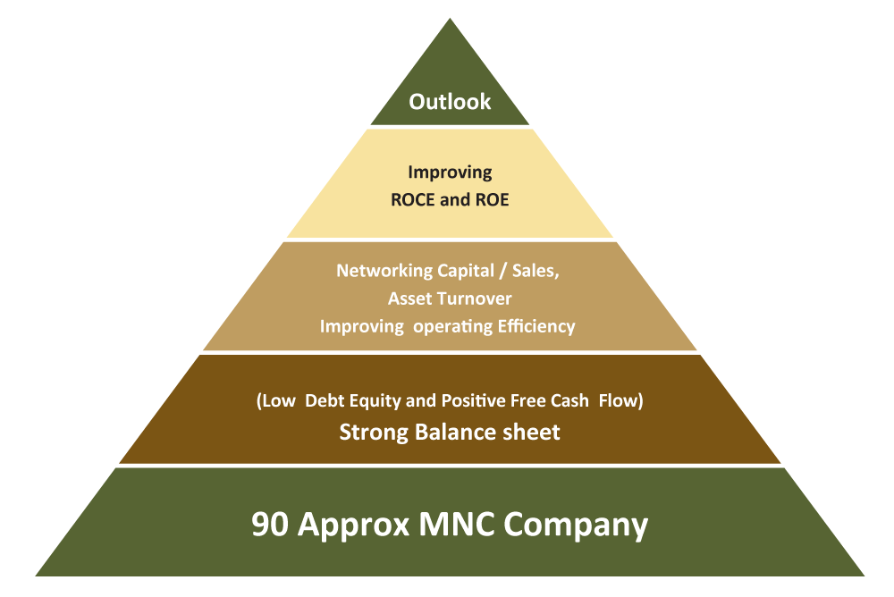
Selection Process
Out of 4500 listed Company, there are only 90 odd MNC Companies which are own by Foreign Promoter with more than 2000 cr Market Cap which make the stock universe limited for further evaluation.

Slide 19
Well Balanced Defensive but Growth
Consumer non Discretionary
  Staple and Healthcare
  Companies Like Hindustan Unilever, Nestle, Britannia, Colgate,
  Glaxo Consumer etc.
  Pfizer, Abbot lab, Glaxo Pharma, Sanofi, Astrzenca.
This Bucket is Expected to show Steady and Nominal growth
Consumer Discretionary
  Auto, Paint, Consumer Durables etc
  Maruti, Wabco, 3M India, Bata, Whirpool, Bosch, Johnson Hitachi,
  Kansai Nerloac, Akzo Nobel, Castrol, Gulf oil Lubricant etc.
This Bucket Does Well with normal Economic Growth
Cyclical /Others
  Cement, Engineering, Electricals, Capital Goods, Metals, IT, Chemicals etc.
  ACC, Ambuja, Heidelberg, Simenes, ABB, Honeywell ,
  Grindwell Norton, GMM Pfaudler, Mphasis, Bayer Crop,
  BASF, Oracle Financial, Crisil , Schaeffler, SKF etc.
This Bucket Does Well when economic growth is strong
The three bucket strategy with shifting allocation as per the market outlook help to further optimize the returns, However Consumables remains the core part of the portfolio.

Slide 20
Growth like Multicap but Quality like Large Cap
• MNC PMS is a Multicap Portfolio with all market capitalization. (large, Mid, Small)
• There are many companies which by Indian Market Cap Definition are called as Midcap Companies
where as by Global Definition these are Large cap.
• One gets benefit of growth like Midcap Companies in India where as Quality of Large Cap. Few Eg given below
Pfizer
  Midcap in India
  Biggest Pharma Company in World
3 M India
  Midcap in India
  Part of Dowjones 30 index
Bata India
  Midcap in India
  125-year-old Company operates in
  70 Countries

Slide 21
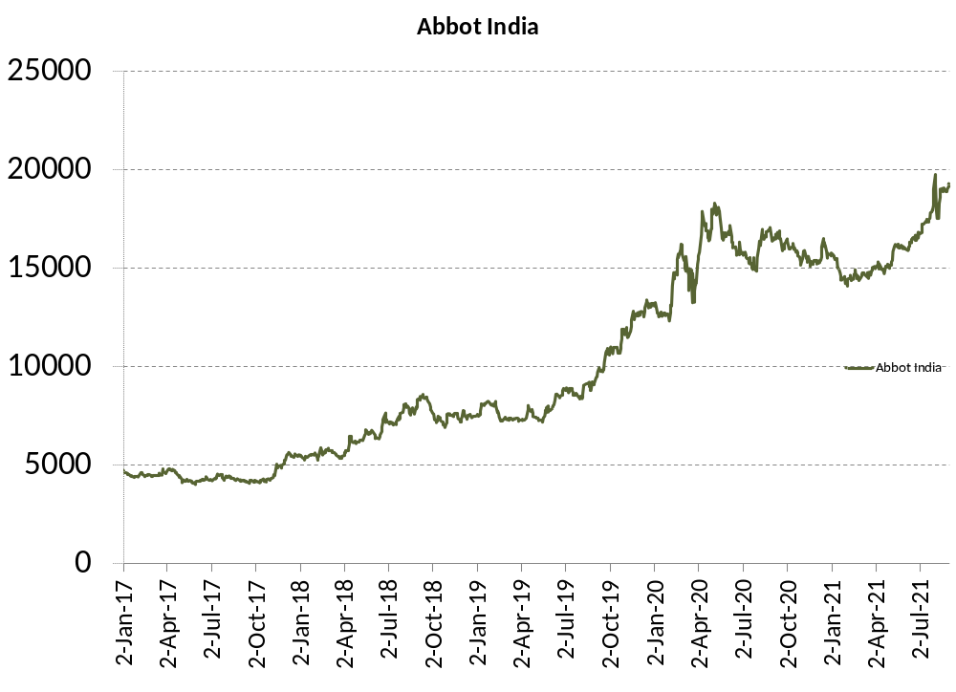
Success Stories - Abbott India
Abbott India
Strong Parentage : Abbott Laboratories USA
Offering high-quality trusted medicines in multiple therapeutic categories such as women's health, gastroenterology, cardiology, metabolic disorders and primary care.
Key Brands : Duphaston, Thyronorm, Udiliv, Digene, Cremaffin, Duphalac
Balance Sheet Strength: Zero Debt, Positive Cash Flow and ROE Maintained above 20% over last 5 years
Partial Profit Book
Initial buy
Focus strategy
1) to accelerate key brands
2) Drive therapy leadership
3) Strengthen Multi-channel and insight driven marketing
4) Identify new product opportunity
5) Focus on talent development and engagement
6) 100+ products Launch in last 10 years and more
launches in coming years.

Slide 22
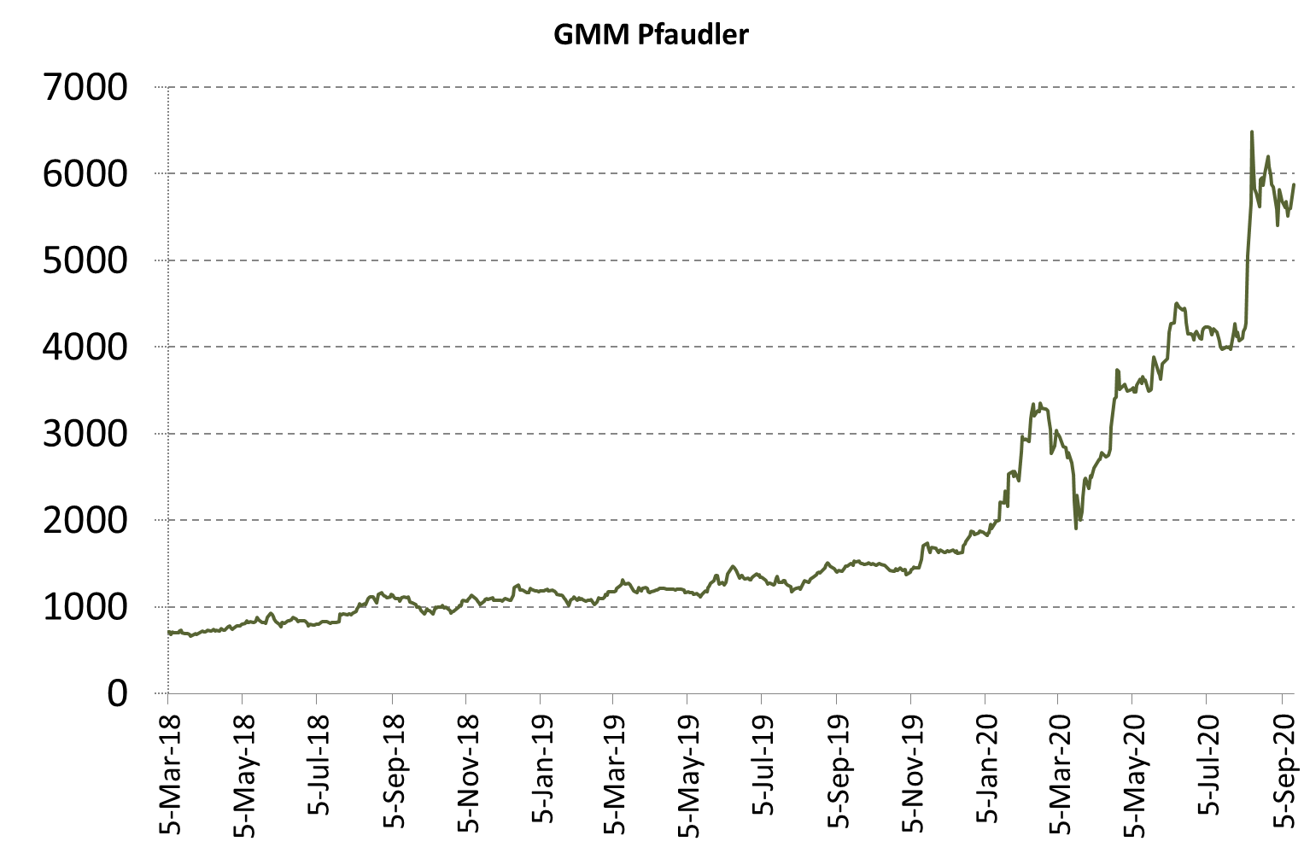
Success Stories - GMM Pfaudler
GMM Pfaudler
Foreign Promoter: Pfaudler Inc.
A leading supplier of glass lined based equipment (reactors, storage tanks) in India, commanding > 50% domestic market share, finding critical application in the chemical & pharmaceutical industries.
Benefit from Domestic Chemical, Pharma and Agrochemical capacity addition post Shut down of industries in China.
Balance Sheet Strength: Zero Debt, Positive Cash Flow and ROE Maintained above 20% over last 5 years.
Full Profit Book
Partial Profit
Book
Initial buy
Focus strategy
1) to accelerate key brands
2) Drive therapy leadership
3) Strengthen Multi-channel and insight driven marketing
4) Identify new product opportunity
5) Focus on talent development and engagement
6) 100+ products Launch in last 10 years and more
launches in coming years.

Slide 23
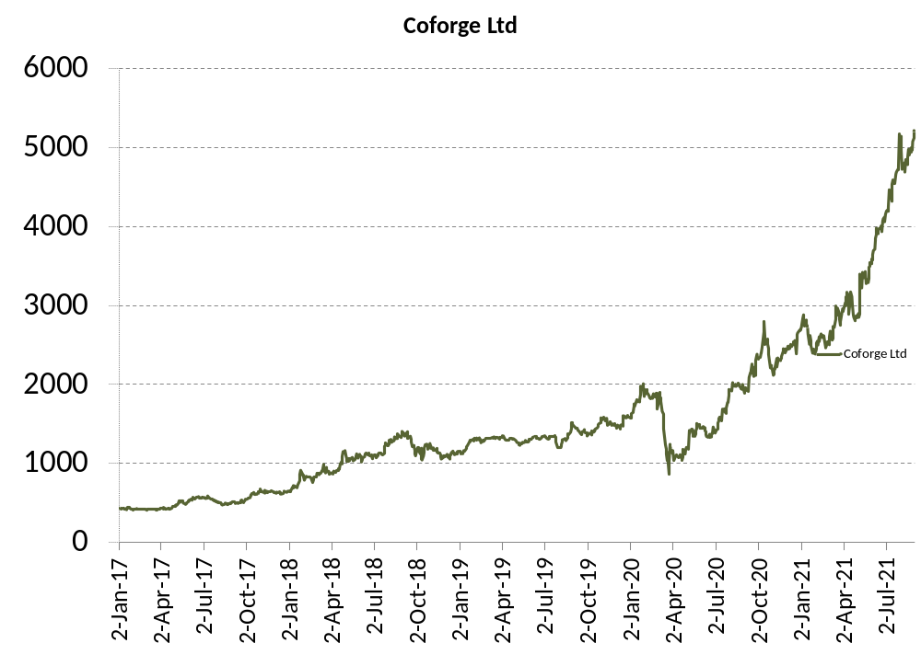
Success Stories - Coforge Ltd.
Coforge Ltd.
Still Holding
In 2019 NIIT ltd sold its stake in NIIT Technology to foreign player Barings. The company rebranded to name it COFORGE ltd.
Over the Last 5 years Revenues for the company has grown by 10% plus CAGR and PAT has grown by 25% plus CAGR. Operating margin is maintained around 17% throughout.
The company has three key verticals Banking and Financial contributing (17%), Insurance (30%) , Travel and Transportation (29%) and Others (24%). Geography wise America contributes 48%, EMEA 37%, ROW 15%. In terms of service Mix ADM Contributes 73%, IMS 16% and IP Based 6% and others.
Initial buy
Despite COVID except for Travel business most business is doing good with constant addition of new clients especially healthcare. Company continues to remain confident about its near- medium-term growth prospects, citing its strong order booking/pipeline and its investments in building strong sales and leadership.

Slide 24
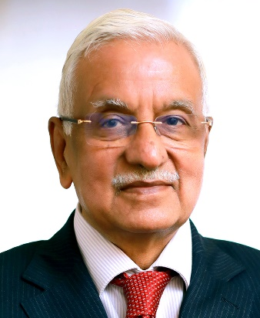
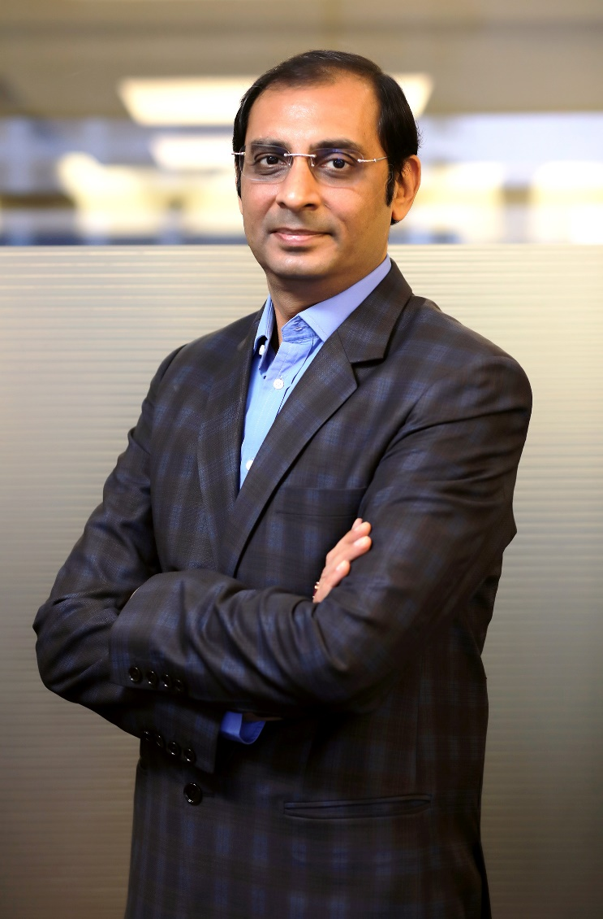
Founder & Promoter (Anand Rathi Group)
Gold medalist Chartered Accountant having more than four decades of rich and varied experience in corporate management, financial & capital markets and corporate & management consultancy.
Served Aditya Birla Group at very senior positions for more than 25 years before starting his own financial services outfit. Shri Rathi was earlier President of BSE for two terms.
Anand Rathi Group derives its strength and vision from legendary leadership of Shri Anand Rathi and charting growth path in his able guidance.
Anand Rathi
Founder & Chairman
Over twenty years broad based experience in the securities market and key driver of the Retail and Institutional Equities business of the group.
Under his leadership, the Group’s Institutional & Retail Business has won great recognition and many accolades. He has played a pivotal role in the Group’s network expansion and pan India growth.
His valuable contribution towards professionalizing the management of the Group has won him immense respect from the corporate world.
Pradeep Gupta
Co Founder &
Vice Chairman

Slide 25
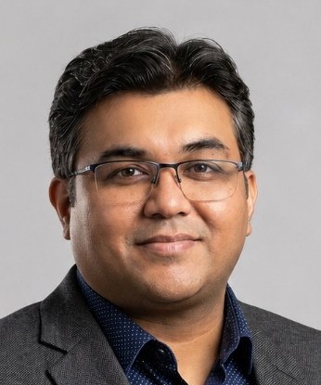
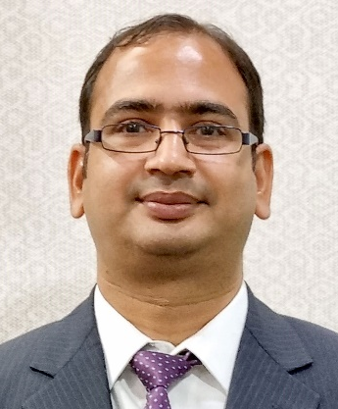
Fund Management Team
More than 21 years of rich experience in Investment advisory, Product Development and Portfolio Management.
Working with Anand Rathi since 2007 across Portfolio Management and Private Client Group Equity Advisory.
Started Career with “Kotak Securities Ltd” in 2005 as an Investment Advisor subsequently got into developing Equity products and running the same.
Qualified MBA (Finance) from Mumbai University and Certified Financial Planner.
Mayur Shah
Fund Manager
More than 22 years of rich experience in Investment advisory, Portfolio Management and research.
Worked in past with Standard Chartered Securities, Religare Securities, Enam Securities.
PGDBM from Mumbai.
Vinod Vaya
Vice President

Slide 26
Product Features
MNC Portfolio
Minimum investment
Portfolio:
Themes offered
Risk – reward & tenure
Type of instruments
Benchmark
Rs. 50 lakhs
15-20 STOCKS, diversified across sectors.
Diversified portfolio of Multinational Companies listed in India with controlling stake with foreign holder
Moderate risk reward. Investment tenure preferably 3 years+
Equity & Equity Related Instruments, Fixed Income Instruments, Cash & Cash Equivalent
BSE 500 TRI
Fees & Charges
Benefits
Dedicated Web Login for client to monitor portfolio.
A relationship manager to cater to investment needs
Constant monitoring of the portfolio
Audited statement at year end for tax filing purpose.
Support
Back office customer service desk to address client queries
AMC fees : 2.5% p.a (Charged Pro-rata at end of each quarter)
Brokerage : 0.10% on Equity delivery transaction
Exit Load : 2% - 1st Year, 1% - 2nd Year, NIL after 2nd Year
Other Charges : GST, Other charges levied by Exchange, Custodial charges (3 bps) levied by custodian and any other statutory charges.

Slide 27
Specific Disclaimer
All Investment are subject to Market Risk.
Please read the risk factors before investing in the same.
Past Performance is not necessarily indicative of likely future performance
Registration Details
Direct On-Boarding
PMS registered under : Anand Rathi Advisors Ltd.
PMS Registration Number : INP000000282.
Custodian : Orbis Financial Corporation Ltd.
To invest directly into our PMS, please:
Mail: pmsdesk@rathi.com
Contact: 022-62813851, 52
Or click here: https://www.anandrathipms.com/contact-us.php
Product Support
Back Office Support
More Information
Name : Vinod Vaya
Tel : 022 - 6281 3851
Email ID : vinodvaya@rathi.com
Name : Manan / Sourabh
Tel : 022 – 6281 1556
Email ID : pmsdesk@rathi.com
Visit Our Website: https://www.anandrathipms.com
Click here for Disclosure Document
OFFICIAL ADDRESS: 10th Floor, Express Zone - A Wing, Western Express Highway, Malad (East),
Mumbai - 400063, India
BOARD LINE : +91 22 6281 7000

Slide 28



THANK YOU
Disclaimer:-This presentation has been issued by Anand Rathi Advisors Limited (ARAL), which is regulated by SEBI. Neither the information nor any opinion expressed constitutes an offer, or an invitation to make an offer, to buy or sell any securities or any options, futures or other derivatives related to such securities ("related investments"). ARAL and its affiliates may trade for their own accounts as market maker / jobber and/or arbitrageur in any securities of this issuer(s) or in related investments, and may be on the opposite side of public orders. ARAL, its affiliates, directors, officers, and employees may have a long or short position in any securities of this issuer(s) or in related investments. ARAL or its affiliates may from time to time perform investment banking or other services for, or solicit investment banking or other business from, any entity mentioned in this report. This presentation is prepared for private circulation. It does not have regard to the specific investment objectives, financial situation and the particular needs of any specific person who may receive this report. Investors should seek financial advice regarding the appropriateness of investing in any securities or investment strategies discussed or recommended in this report and should understand that statements regarding future prospects may not be realized. Investors should note that income from such securities, if any, may fluctuate and that each security's price or value may rise or fall. Past performance is not necessarily a guide to future performance. Foreign currency rates of exchange may adversely affect the value, price or income of any security or related investment mentioned in this report.

